Slide 1
Chapter - 9
Pointers, Virtual Functions and Polymorphism
Book Referred: Object-Oriented Programming with C++ by E Balaguruswamy
(8th Edition) – Chapter 9
Prepared By: Dr. Anuja Nair, Assistant Professor,
CSE Department, Nirma University

Slide 2
Concepts Included
Polymorphism
Pointers
Pointers to objects
this pointer
Pointers to derived classes
Virtual functions
Pure virtual function

Slide 3
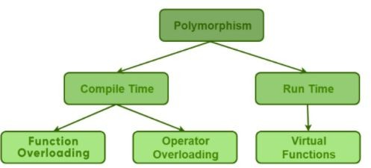
Polymorphism
Compile time polymorphism → early binding/static binding/static linking
Run time polymorphism → late binding/dynamic binding → requires pointers to objects

Slide 4
Pointers
Declaring and initializing pointers
Manipulation of pointers
Pointer expressions and pointer arithmetic

Slide 5
Using pointers with Arrays and Strings
We can declare the pointers to arrays as follows:
int *ptr;
ptr = number[0]; OR
ptr = number;
Here, ptr points to the first element of the integer array, number[0].
ptr++; or ++ptr; or ptr--; or --ptr;
In C++, there is no automatic array bounds checking.
Suppose we declare an array of size 25. The compiler issues no warnings if we attempt to access 26th location. It is the programmer's task to check the array limits.
Refer 9a.cpp

Slide 6
Array of Pointers
Similar to other variables, we can create an array of pointers in C++.
The array of pointers represents a collection of addresses. By declaring array of pointers, we can save substantial amount of memory space.
An array of pointers point to an array of data items.
Each element of the pointer array points to an item of the data array. Data items can be accessed either directly or by dereferencing the elements of pointer array.
We can declare an array of pointers as follows:
int *inarray[10];
Refer 9b.cpp

Slide 7
Pointers and Strings
In C++, a string (C-style string) is stored as an array of characters ending with a null character '\0'.
char str[] = "hello";
Memory Representation:
h e l l o \0
A pointer can be used to point to a string because a string’s name itself acts like an address of the first character.
1. Pointer to a String Literal
char *p = "hello";
"hello" is stored in read-only memory
p stores the address of 'h'
So, p points to the whole string.
p → h e l l o \0
But we should not modify this string, because it's read-only:
p[0] = 'H'; // Error (undefined behavior)

Slide 8
Pointers and Strings
2. Pointer to a Character Array
char str[] = "hello";
char *p = str;
Here,
str is an actual mutable array in memory.
p points to the same array, so modification is allowed.
p[0] = 'H'; // Valid
str → H e l l o \0
p ───┘
Refer 9c.cpp

Slide 9
Pointers to Functions
Just like we can store the address of a variable in a pointer, we can also store the address of a function in a pointer.
This lets us:
Call a function using a pointer
Pass functions as arguments to other functions
Syntax: return_type (*pointer_name)(parameter_list);
Example: int (*p)(int, int);
This means p is a pointer pointing to a function that returns int and takes two integers as parameters.
Refer 9d.cpp and 9e.cpp

Slide 10
Pointer to object
A pointer to an object is a pointer that holds the memory address of an object. Using pointers to objects allows for dynamic memory allocation, polymorphism, and efficient manipulation of objects in programs.
Syntax:
ClassName* ptr;
ptr is a pointer that can store the address of an object of type ClassName.
Refer 9f.cpp

Slide 11
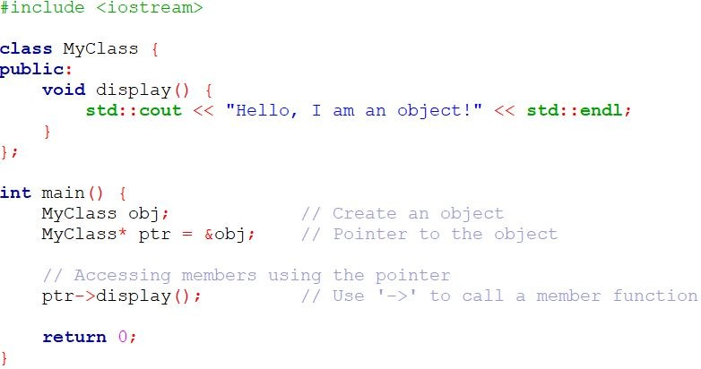
Example

Slide 12
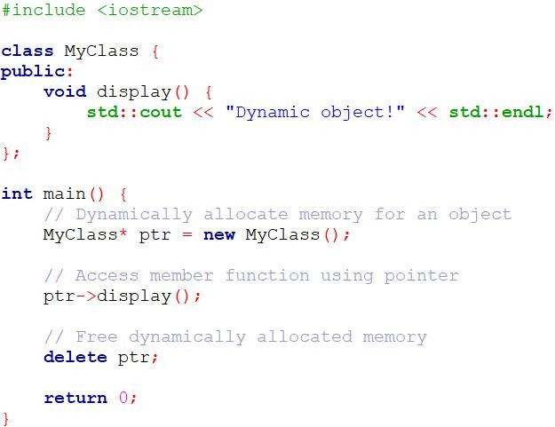

Dynamic Memory Allocation for Objects
Pointers can be used to dynamically allocate memory for objects using the new keyword.

Slide 13
this pointer
The this pointer is an implicit pointer available in all non-static member functions of a class. It points to the object for which the member function is called.
The this pointer is particularly useful when you need to refer to the current object, especially when distinguishing between class members and local variables or parameters with the same name.
Scope: It is available in non-static member functions of a class. Static member functions do not have access to the this pointer because they are not tied to any specific object.
Type: The type of the this pointer is a pointer to the class type (ClassName*), and it points to the memory address of the object invoking the member function.

Slide 14
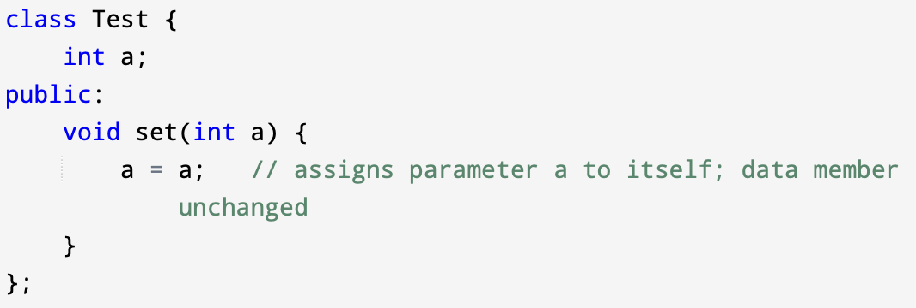
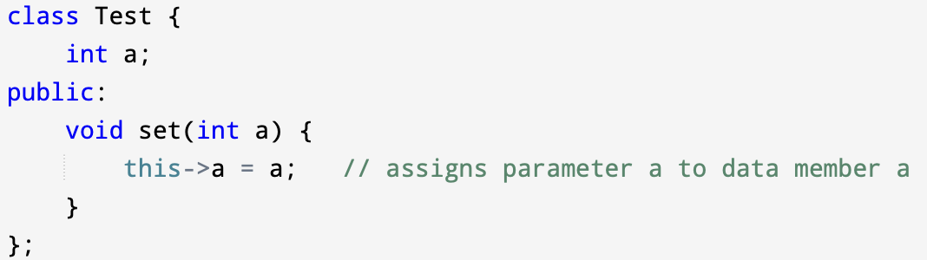
this pointer
In C++, every object has its own address in memory. Inside a member function, the keyword this stores the address of the object that is calling the function.
this → pointer to the current object
It is automatically provided by the compiler - you do not need to declare it.
To distinguish between:
Member variables (data members)
Local variables or function parameters with same names

Slide 15
this pointer
One another important application of the pointer this is to return the object it points to. For example, the statement
return *this;
inside a member function will return the object that invoked the function. This statement assumes importance when we want to compare two or more objects inside a member function and return the invoking object as a result.
Refer 9g.cpp and 9h.cpp

Slide 16
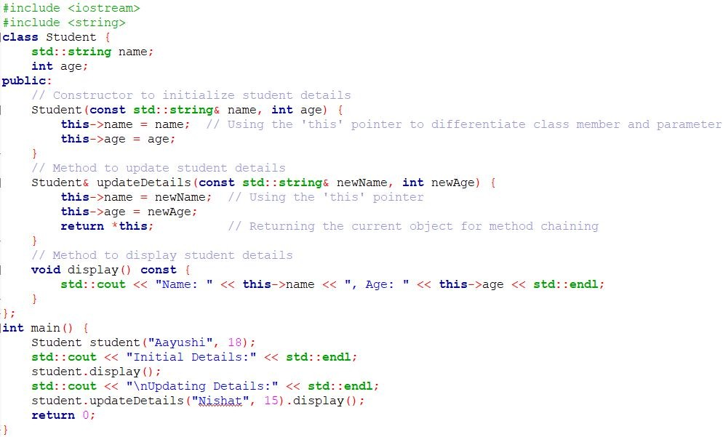
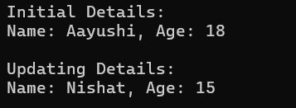
Accessing Members using this pointer The this pointer allows access to the invoking object's members directly.

Slide 17
Pointers to Derived Classes
If class D is derived from class B, then:
B *ptr; // pointer of base class
D d; // object of derived class
ptr = &d; // base class pointer can point to derived object
This is allowed because a derived object contains all members of the base class.
But there is a limitation.
When we use a base class pointer (B*) to refer to a derived object (D):
We can access only the base class members
We cannot access the members added in the derived class
Why? Because the type of the pointer decides what members are accessible, not the object it points to.

Slide 18
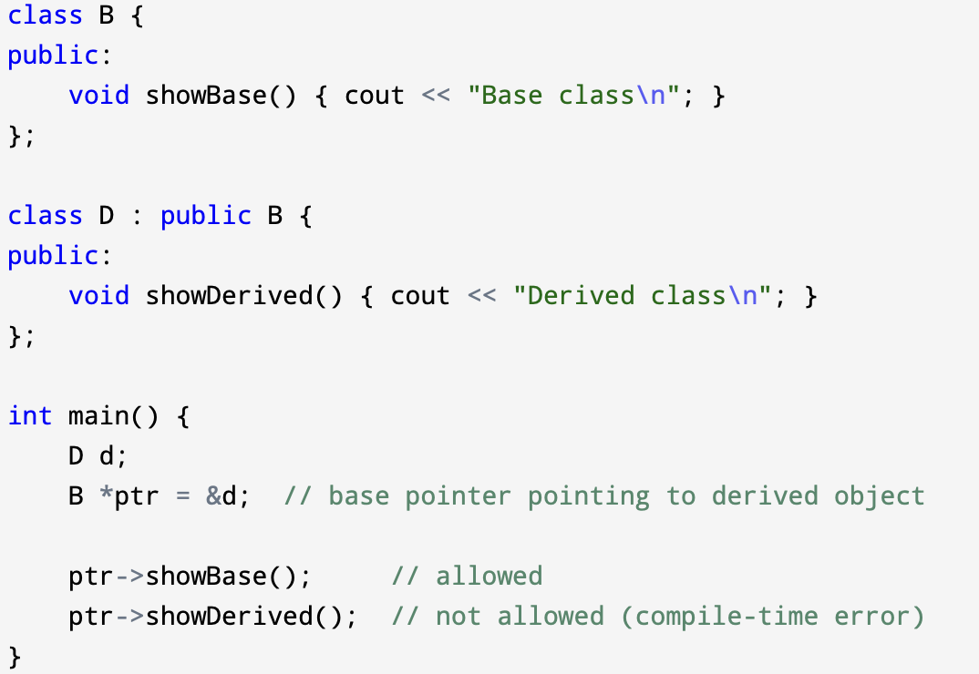
Pointers to Derived Classes
Even though d has showDerived(), we cannot call it using B* pointer.
So to access derived class members, we must use a derived class pointer:
D *dp = &d;
dp->showDerived(); // works

Slide 19
Virtual Functions
There is a necessity to use the single pointer to refer to all the objects of the different classes.
So, we create the pointer to the base class that refers to all the derived objects.
But, when base class pointer contains the address of the derived class object, always executes the base class function.
This issue can only be resolved by using the
'virtual' function.
_{Prepared By: Nishat Shaikh}Unit 7: Operator Overloading

Slide 20
Virtual Functions
Virtual function is a member function in the base class that you redefine in a derived class. It is declared using the virtual keyword.
A 'virtual' is a keyword preceding the normal declaration of a function.
It is used to tell the compiler to perform dynamic linkage or late binding on the function.
When the function is made virtual, C++ determines which function is to be invoked at the runtime based on the type of the object pointed by the base class pointer and not by the type of the pointer.
In late binding function call is resolved during runtime. Therefore compiler determines the type of object at runtime, and then binds the function call.

Slide 21
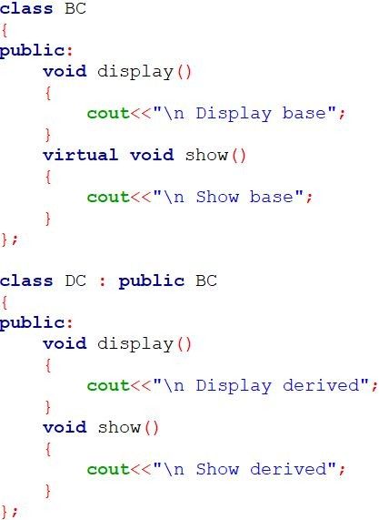
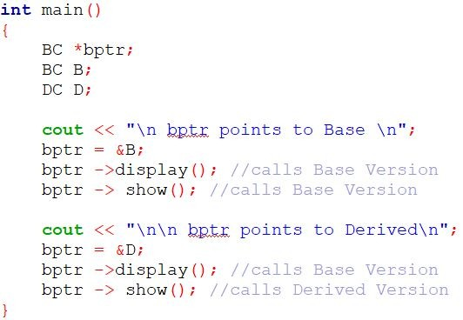
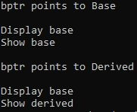
Virtual Functions

Slide 22
Virtual Functions
NOTE:
Run time polymorphism is achieved only when a virtual function is accessed through a pointer to the base class.

Slide 23
Rules of Virtual Function
Virtual functions must be members of some class.
Virtual functions cannot be static members.
They are accessed through object pointers.
They can be a friend of another class.
A virtual function must be defined in the base class, even though it is not used.
The prototypes of a virtual function of the base class and all the derived classes must be identical. If the two functions with the same name but different prototypes, C++ will consider them as the overloaded functions and the virtual function mechanism is ignored
We cannot have a virtual constructor, but we can virtual destructors.

Slide 24
Rules of Virtual Function
While a base pointer can point to any type of the derived object, the reverse is not true. That is to say, we can not use a pointer to a derived class to access an object of base type
When a base pointer points to a derived class, incrementing or decrementing it will not make it to point to the next object of the derived class. It is incremented or decremented only relative to it’s base type. Therefore, we should not use this method to move the pointer to the next object.

Slide 25

Virtual Destructors
A virtual destructor ensures that the correct destructor of the derived class is called when an object is deleted through a base class pointer.
Without a virtual destructor, only the base class destructor runs, and this can lead to resource leaks or incomplete destruction of derived objects.
Rule of Thumb
If your class has virtual functions, always make
the
destructor virtual, especially if it will be inherited.

Slide 26
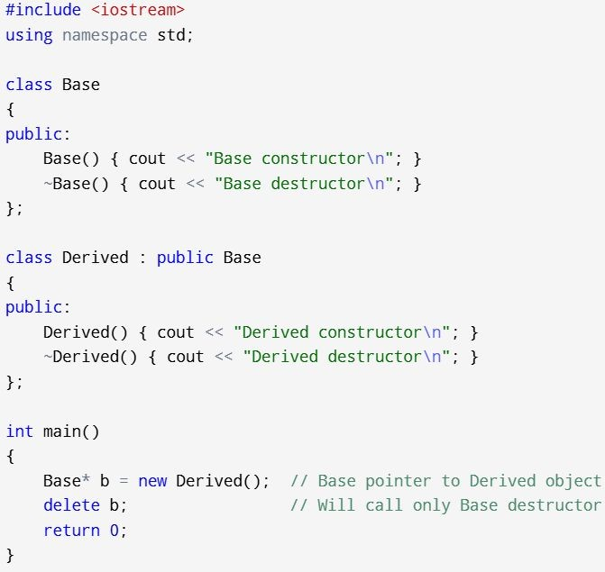

Without Virtual Destructors

Slide 27
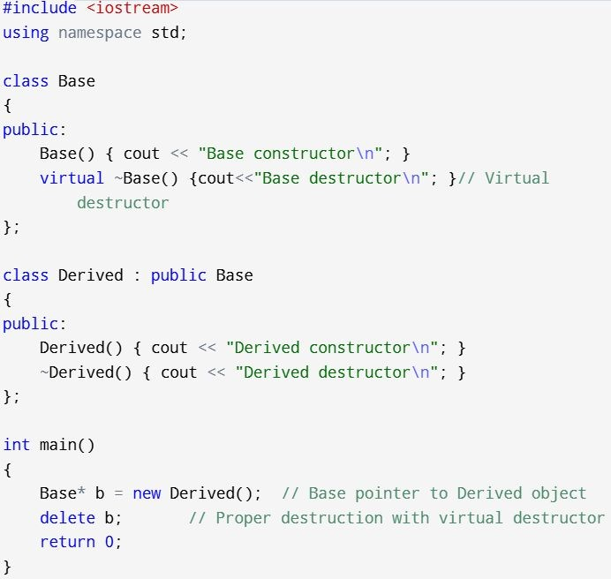
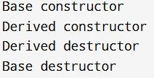
With Virtual Destructors

Slide 28
Practical : Virtual function
Create a class Media that stores the title (a string) and price (float). Class Media has two argument constructor which initializes data members of class Media. Also declare a virtual function display () in Class Media. From the class Media derive two classes: Class book, which contains data member page count (int): and Class tape, which contains data member playing time in minutes (float). Both Class book and Class tape should have a constructor which initializes base class constructor as well as its own data members and display ( ) function which displays book details and tape details respectively. Write a main ( ) to test book and tape classes by creating instances of them, asking the user to fill data and displaying them.
Use the concept of Virtual function and Constructor in

Slide 29
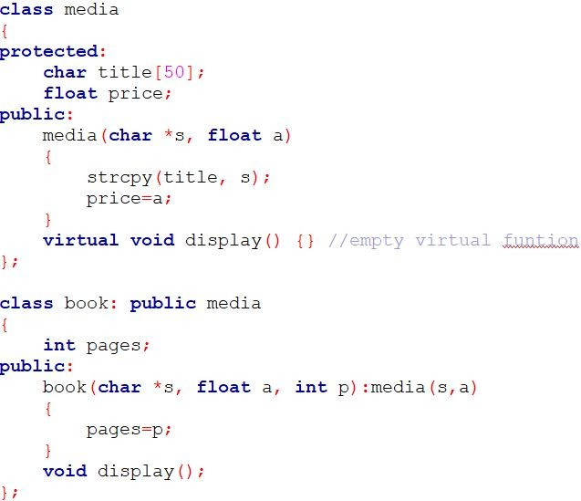
Practical : Virtual function

Slide 30
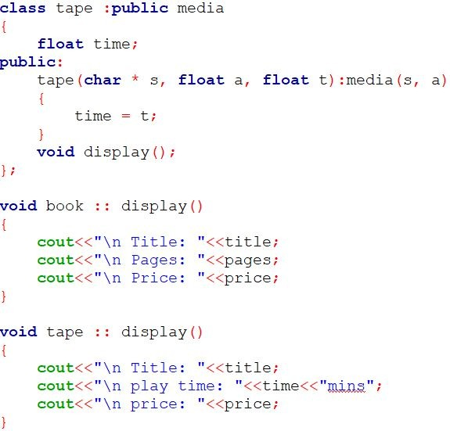
Practical : Virtual function

Slide 31
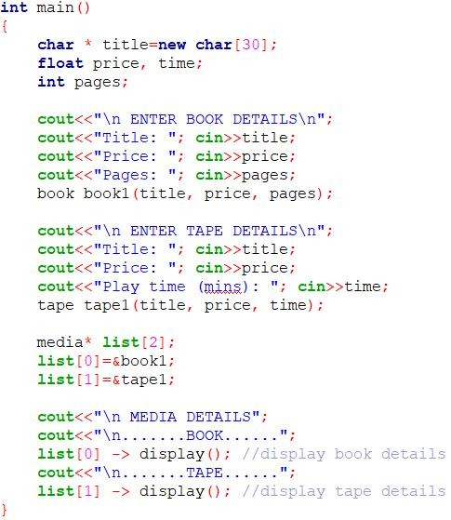
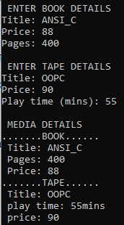
Practical : Virtual function

Slide 32
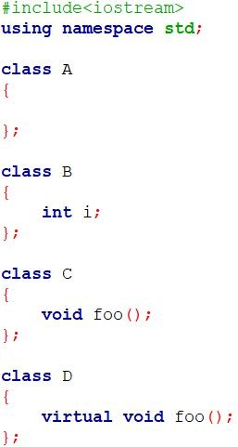
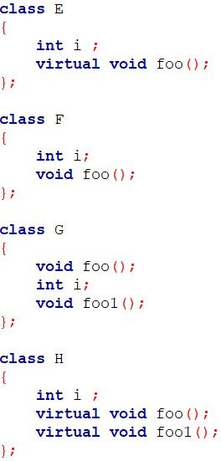
Size of Virtual function

Slide 33
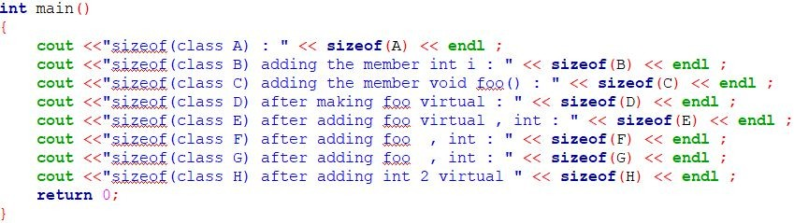
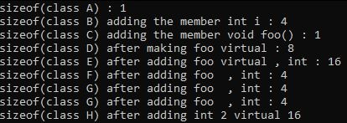
Size of Virtual function

Slide 34
Abstract class & Pure Virtual Functions
It is normal practice to declare a function virtual inside the base class and redefine it in the derived classes.
Such function inside base class is not used for performing any task, it only serves as a placeholder.
For ex, display() function in class Media in previous example. Such functions are called “do-nothing” functio
A “do-nothing” function may be defined as follows:
Such functions are called pure virtual functions
ns.

Slide 35
Abstract class & Pure Virtual Functions
A pure virtual function is a function declared in a base class that has no definition relative to the base class.
In such case compiler requires each derived class to either define the function or redeclare it as a pure virtual function.
Class containing pure virtual functions cannot be used to declare any objects of its own and such classes are called abstract base classes

Slide 36
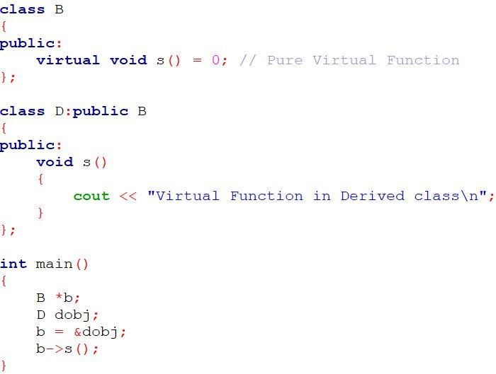
Abstract class & Pure Virtual Functions

Slide 37
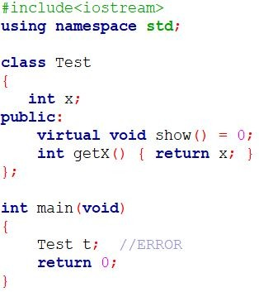

Abstract class & Pure Virtual Functions
NOTE:
1. A class is abstract if it has at least one pure virtual function.

Slide 38
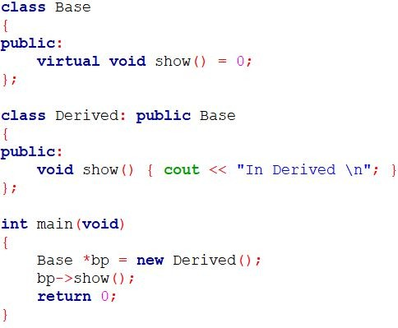
Abstract class & Pure Virtual Functions
2. We can have pointers and references of abstract class type.

Slide 39
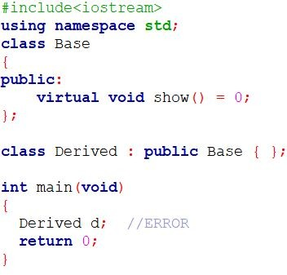

Abstract class & Pure Virtual Functions
3. If we do not override the pure virtual function in derived class, then derived class also becomes abstract class.

Slide 40
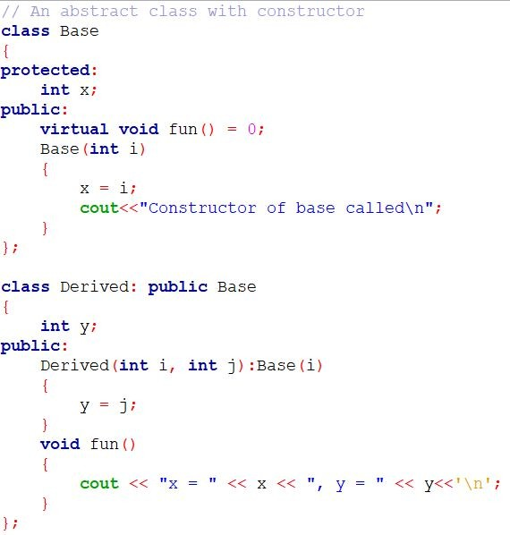
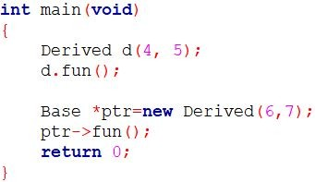

Abstract class & Pure Virtual Functions
4. An abstract class can have constructors.
_{Prepared By: Nishat Shaikh}Unit 9: Pointers and Virtual Functions

Slide 41
Practical :Abstract class & Pure Virtual Functions
Create an Abstract class vehicle having average as data and pure virtual function getdata() and putdata(). Derive class car and truck from class vehicle having data members: fuel type (petrol, diesel, CNG) and no of wheels respectively. Write a main ( ) that enters the data of two cars and a truck and display the details of them.
Use the concept of Abstract Base class and Pure Virtual functions.

Slide 42
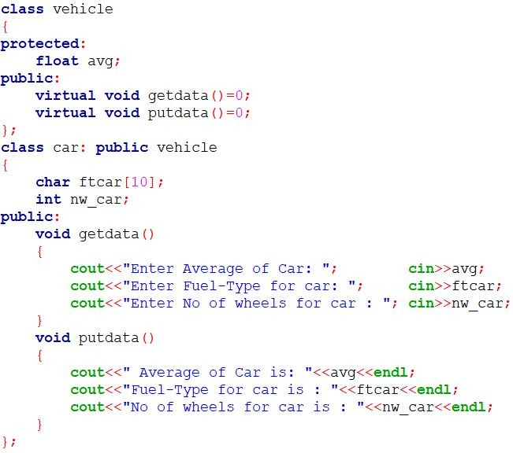
Practical :Abstract class & Pure Virtual Functions

Slide 43
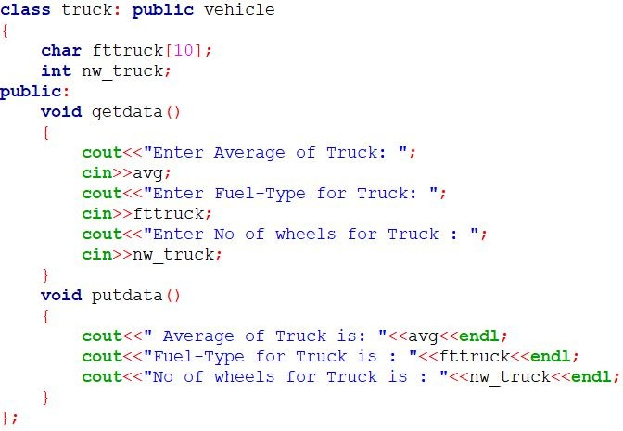
Practical :Abstract class & Pure Virtual Functions

Slide 44
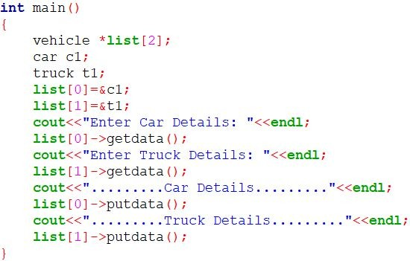
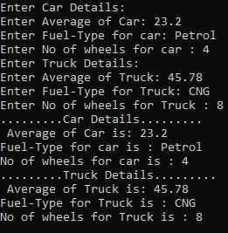
Practical :Abstract class & Pure Virtual Functions

Slide 45
Thank You

